Slide 1

Voice-Based Email & Messaging Assistant – Hands-Free Communication for All
Presented By : Abhinav Gupta

Slide 2
What we are Going ( Roadmap)
Milestone 1 (NOW)
The Foundation
Google Oauth authentication, Biometric Login, Database Schemas & Voice Loops.
Milestone 2
The Connector
Connecting to Gmail, So it can read the inbox, NLU to understand Commands
Milestone 3
The Brain
Adding AI to summarize long messages into speech –friendly summaries
Milestone 4
Deployment & Security
Dockerizing the app and adding Voice PINs for 2-Factor Authentication.

Slide 3
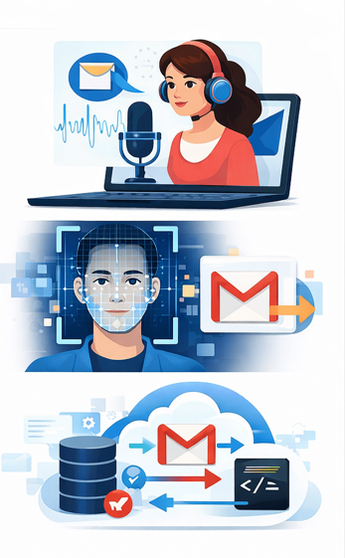
Milestone 1 Achievements
Added Face Recognition Authentication for secure access
Designed a secure database to store user and authentication data
Successfully connected with Gmail API for sending & reading emails
Implemented Speech-to-Text (STT) for voice-based email composing
Integrated Text-to-Speech (TTS) to read emails aloud
Improved accessibility for visually & physically impaired users

Slide 4
Table of contents
01
02
03
04
05
06
Project Overview
Problem Statement
The Solution
Technology Stage
Work Flow Diagram
Streamlit UI

Slide 5

Project Overview & Vision
The Voice-Based Email & Messaging Assistant offers secure, hands-free email interaction. It integrates voice commands and biometric authentication for accessible email content reading.
Our vision is to enhance accessibility, security, and ease of communication for all users, making digital interaction seamless and inclusive.

Slide 6
Problem Statement
Manual Interaction
Traditional email systems demand constant manual effort, limiting usability for many.
Accessibility Barriers
Difficult for visually impaired or users with busy hands to manage emails effectively.
Security & Convenience
Password-based authentication lacks both convenience and robust security.
Fragmented Solutions
No unified system combines voice control with secure biometric login for email.

Slide 7
The Solution – Voice Based EMAIL
Solution Overview
The proposed solution is a Voice-Based Email & Messaging Assistant that enables users to securely access and read their email inbox using voice commands and face-based authentication, ensuring hands-free and accessible communication.
Key Solution Components
User Registration & Login using facial recognition for secure authentication
Voice Command Interface to control email actions without manual input
Gmail API Integration to fetch inbox email snippets securely
Text-to-Speech Engine to read email snippets aloud to the user
Streamlit-Based Interface for a clean and responsive user experience

Slide 8
Technology Stack
Frontend & User Interface
Streamlit Used to build an interactive and responsive web-based user interface for login, inbox display, and voice interaction.
Voice Processing
Speech-to-Text (Google SST) Converts user voice commands into text for processing.
Text-to-Speech (gTTS) Converts email snippets into spoken audio for hands-free interaction
Backend & Core Logic
Python Handles application logic, API integration, voice processing, and system workflows.
Email Integration
Gmail API Fetches email inbox metadata and snippets securely.
Google OAuth 2.0 Provides secure authorization for accessing Gmail services.
Authentication & Security
Face Recognition (DeepFace – ArcFace) Ensures secure user authentication using facial verification.
SQLite Database Stores user credentials, face image references, and Gmail tokens securely.

Slide 9
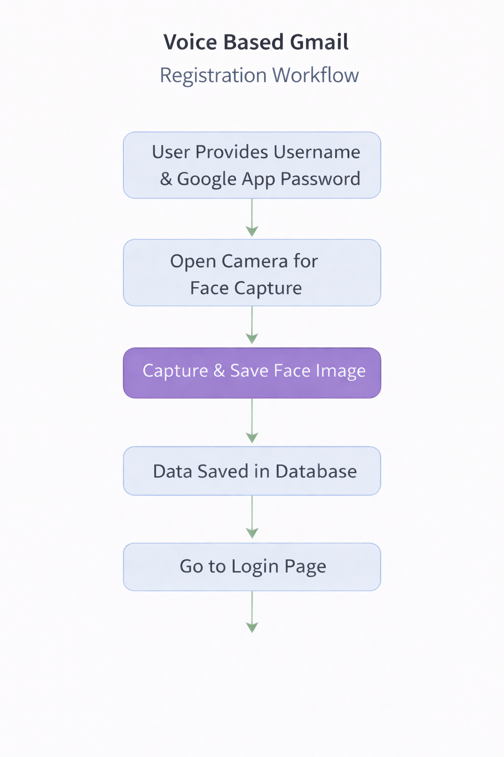
Register Page Work Flow Diagram

Slide 10
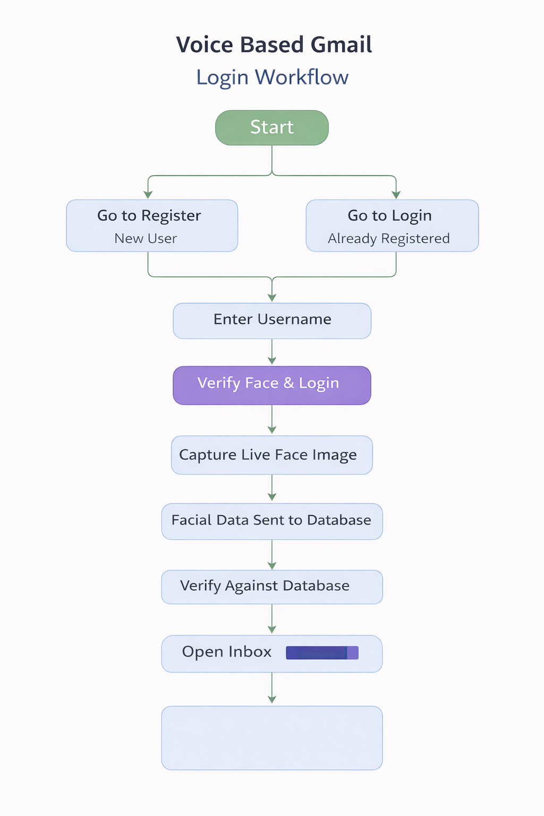
Login Page Work Flow Diagram

Slide 11
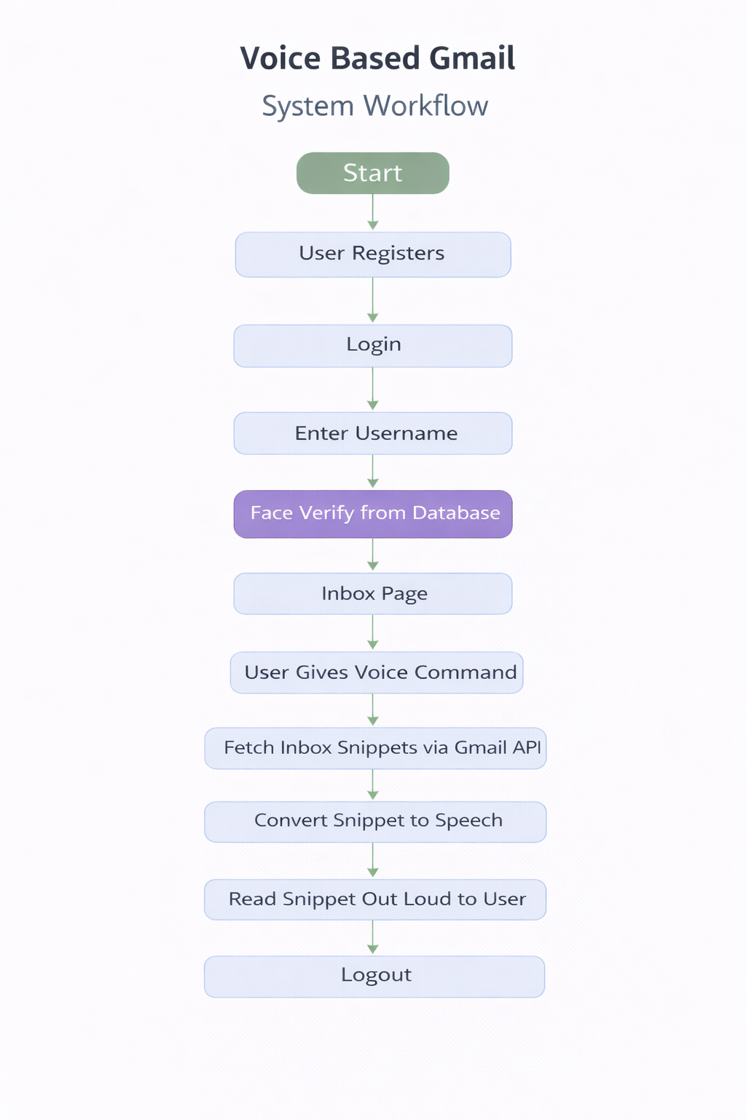
System Work Flow Diagram

Slide 12
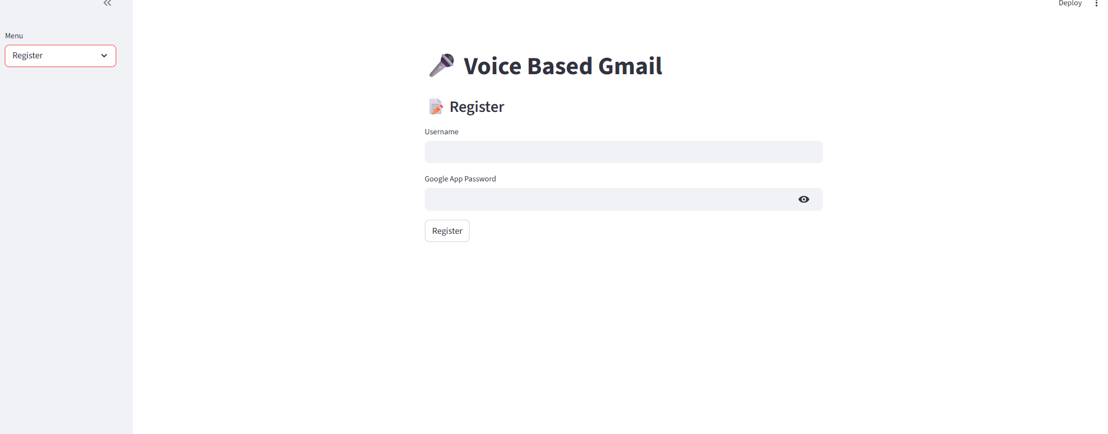
Register Streamlit UI

Slide 13
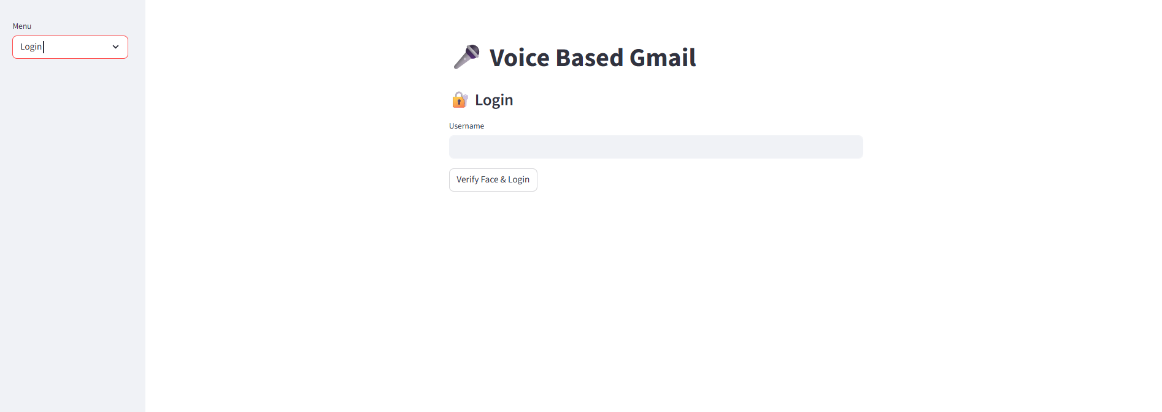
Login Streamlit UI

Slide 14
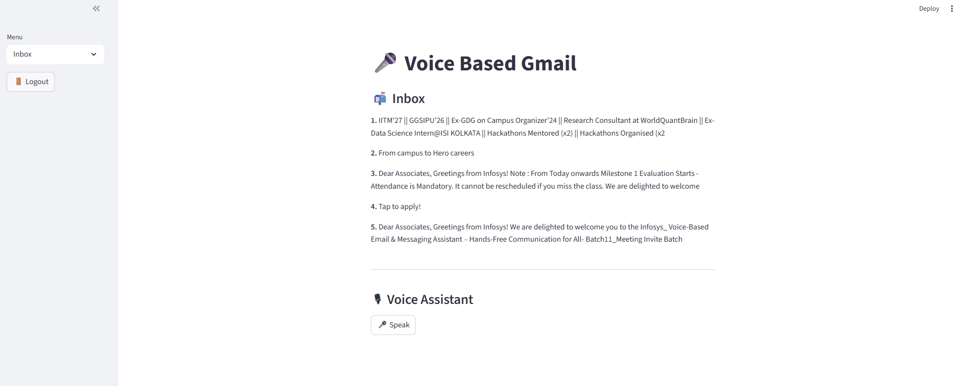
Inbox Streamlit UI

